Slide 1

C language game application
ADVISER
Teacher Suaida Buenae 562431020 Zuraida Leeyanalae

Slide 2
INTRODUCTION
Computer games are one of the most popular types of entertainment in nowadays, and Games are also used in teaching to encourage students to be more interested in learning.
The Design and development of C language game application for students are educational media that allow students to learn in basic C language and games to practice from what they had learned.

Slide 3
PROBLEM STATEMENT
Students are more interested in playing games than reading books.
Not many games related to C language.

Slide 4
OBJECTIVE
To design and develop C language game application for motivate students to learn.
This game is basic game and learn about C language for students to be able to read books by playing games.

Slide 5
PROJECT SCOPE
Develop C language game application for motivate students to learn C language.
Develop for students who register in C language subject of Information Technology major and general interest.
C language game is integration of by using 2 Dimension(2D).
C language Game use only English language.
Develop for Android operating system.

Slide 6
PROJECT STRUCTURE
C language game
Main menu
C language learn
Game
About
Exit
Keywords and Identifiers
Money list
About us
Variables and Constants
Game
Data Types
Input Output
Operators

Slide 7
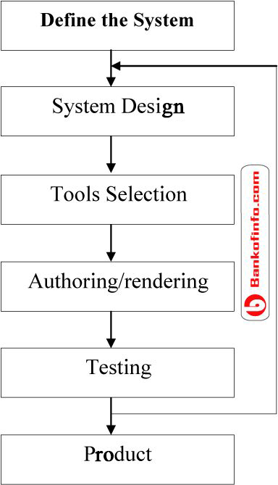
METHODOLOGY
Figure : Multimedia Development Life Cycle Apply Method

Slide 8
SUMMARY
This project is consisting of some information about development game application of C language game , which describe the base of game, the problem, the objective and scope of the project. This project uses the Multimedia Development Life Cycle method (MDLC) to be guideline about how to process this project step by step to be successful.

